Slide 1
Photo: Climate Alliance
Notes:
CITY CYCLING is a campaign by Climate Alliance.

Slide 2
Keep it short!
All of the different components of the CITY CYCLING campaign are outlined in this presentation – it is therefore quite long.
Be sure to consider your audience’s attention span and to only include the slides that you really need and that are interesting and relevant to them.
You can answer questions from the audience afterwards.
PLEASE NOTE: More detailed information is provided in the notes section!
Notes:
Be sure to also check the notes section for more information!

Slide 3
CITY CYCLING
Overview
Notes:
CITY CYCLING essentially comprises three components:
CLICK 1: The core CITY CYCLING campaign.
CLICK 2: The Schulradeln campaign as a (special) competition for schools linked to or integrated into the local CITY CYCLING campaign.
CLICK 3: RADar! reporting platform as a citizen participation tool for planning cycling infrastructure.
CLICK 4: The RiDE digital portal that provides municipalities with more meaningful cycling data to enable them to better plan their local cycling infrastructure.

Slide 4
CITY CYCLING, RADar! & Ride
Successfully shaping the mobility transition
Notes:
All three components have in common that they aim to help municipalities to successfully shape the mobility transition.

Slide 5
Notes:
About CITY CYCLING ...

Slide 6
Photo: Climate Alliance
More people
cycle more!
What is CITY CYCLING?
Competition to promote cycling, help protect the climate and enhance the quality of life in municipalities
Notes:
CITY CYCLING is a competition to promote cycling, help mitigate climate change and enhance the quality of life in municipalities.
All municipalities are invited to participate – whether a town, city, municipality or rural district/region.
CLICK: Ultimately, the aim is to offer a fun approach to help municipalities motivate more people to cycle more.
N.B.: Further texts are concealed behind the green field that will only be visible when the presentation mode is launched!

Slide 7
Photo: Climate Alliance / Felix Krammer
How does it work?
Cycle as many kilometres as possible for business and leisure
Everyone can join in
Cyclist form teams
Notes:
During the CITY CYCLING campaign, people should cycle as many kilometres as possible – whether for business or leisure.
ANYONE can participate and form a team: whether young or old, a student or employee, daily or occasional cyclist ...
The only requirement is that they must live or work, belong to an association or club, or attend a school or university in the participating municipality.

Slide 8
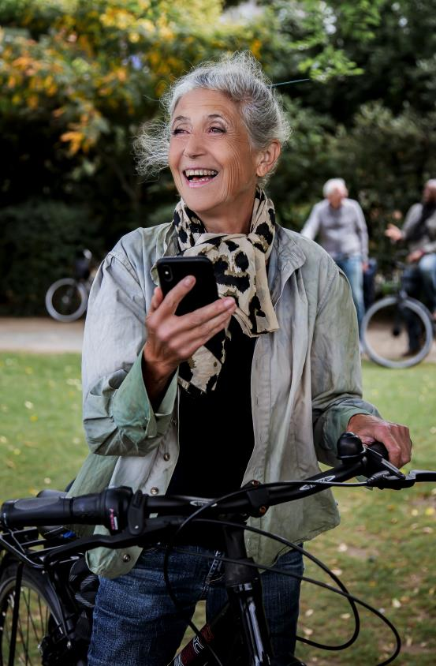
How does it work?
CITY CYCLING campaign season 1 May to 30 September
Local campaign period 21 consecutive days
Enter kilometres online or use the CITY CYCLING app to track them
Photo: Climate Alliance
Notes:
Municipalities are free to decide for themselves when the 21-day local campaign should take place during the annual campaign season that runs from 1 May until 30 September.
The kilometres cycled can be entered on the CITY CYCLING website or tracked directly using the CITY CYCLING app.

Slide 9
Target group
Political decision-makers
Long-term improvement of the cycling infrastructure!
Take the cyclist’s perspective
Demonstrate proximity to citizens
Set a good example
Citizens exert political “pressure”
Perceive cyclists as voters
Photo: Climate Alliance / Felix Krammer
Notes:
One unique feature of the campaign is that the local decision-makers, as the ones responsible for the local cycling infrastructure, are invited to actively participate in CITY CYCLING. The aim is for them to experience cycling in their local area, gain first-hand experience and learn where improvements are needed. At the same time, they should consciously serve as role models (also see the next slide on CYCLE STARS) and encourage their fellow citizens to use sustainable, future-proof mobility.
For their part, citizens should send a clear message to politicians with their participation and every kilometre they cycle that cycling should be promoted more.
CLICK: The aim: To raise awareness among political decision-makers of the need to improve the cycling infrastructure.
N.B.: Further texts are concealed behind the green field that will only be visible when the presentation mode is launched!

Slide 10
CYCLE STARS
Leading by example
21 days only by bike – absolutely no travel by car!
If possible, a “local celebrity” and media coverage
Regular experience reports in a CITY CYCLING blog
Photo: Climate Alliance / Felix Krammer
Notes:
The special CYCLE STAR category is also intended to help generate (even more) media coverage of CITY CYCLING and awareness of bicycles as an alternative mode of transport.
All CYCLE STARS to successfully participate in CITY CYCLING will receive a top-quality prize from our partners and supporters at the end of the campaign season (see city-cycling.org/prizes).
For more information, see city-cycling.org/star.

Slide 11
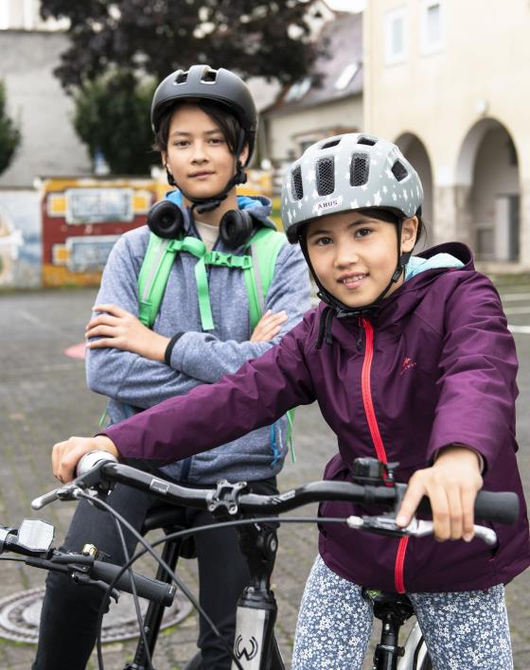
Schulradeln
The competition within the competition
Special competition within CITY CYCLING for schoolchildren. So far, it is offered in:
▪ Baden-Württemberg ▪ Bavaria
▪ Hesse ▪ Lower Saxony
▪ North Rhine-Westphalia ▪ Rhineland-Palatinate ▪ Saarland ▪ Thuringia
Special focus on: schoolchildren, parents and teachers from primary schools to vocational colleges
Creative competitions possible
Awards within the federal states, in part by (state) ministers
Growing popularity
– increasingly important!
Photo: Climate Alliance / Felix Krammer
Notes:
Increasingly popular and important, as crucial target groups receive special attention:
Schoolchildren: their future mobility behaviour is shaped decisively at a young age.
Teachers: reduce commuter traffic, act as role models, raise awareness for sustainable mobility and better cycling infrastructure – especially with regard to parking facilities.
Parents: combat the “parent taxi” phenomenon, children have a positive influence on parents, reduce the daily traffic chaos and associated dangers outside schools.
For all children – from primary schools through to vocational colleges. Can be accompanied by their parents before they’ve completed their cycling proficiency test (usually in Year 4).
The best schools within each federal states are sought, so the schools to cycle the most kilometres (absolute), collect the most kilometres per cyclist (average) and/or motivate the most people to participate. Schools can compare themselves with other schools in their municipality, the entire federal state and across Germany.
Creative competitions can also be implemented in schools and prizes conferred accordingly: school projects and campaigns on cycling/sustainable mobility. Funny, creative ways to combine cycling and school: can be sporty, artistic, scientific or even something completely different. As long as the focus is on cycling!

Slide 12
Schulradeln
How does it work?
Takes place during the local CITY CYCLING campaign
Link to Schulradeln while registering for CITY CYCLING
Subteams for individual classes within a school for added motivation
Federal states responsible (annual licence)
State coordinators responsible for overall coordination
Photo: Climate Alliance
stadtradeln.de/schulradeln
Notes:
Schulradeln automatically takes place during the 21-day local CITY CYCLING period, so the kilometres cycled by schools are also added to the CITY CYCLING total for the municipality.
When registering for CITY CYCLING, schools in the municipality can be selected from a dropdown list (the state coordinators provide and maintain an Excel list of all schools in the federal state). Allowing schools to be clearly registered and avoid multiple registrations.
The subteam option is particularly interesting for schools: If a school is registered as the main team, individual classes can then form subteams – to encourage competition within the school itself, for example. Schools can then also confer awards (e.g. for the best classes).
Responsibility for organisation/implementation is deliberately assigned to the federal states, if necessary also shared between ministries (ministry of transport, the environment or culture, etc.). The federal states must pay a licence fee; participation in the national competition is then free for the municipalities (and schools).
See stadtradeln.de/schulradeln for more information.

Slide 13
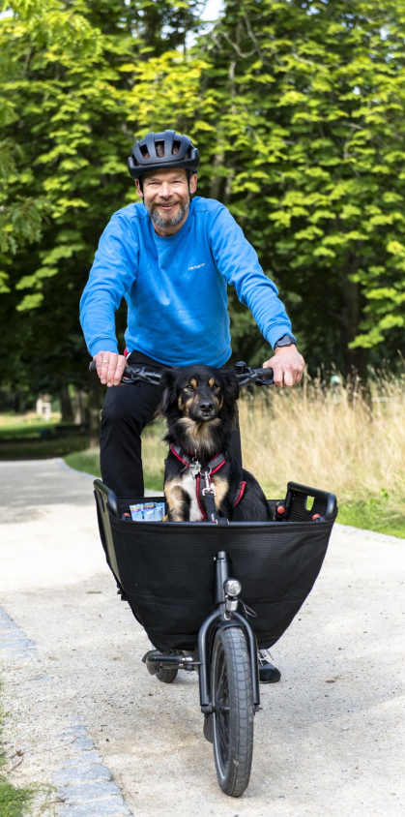
CITY CYCLING goes international
Global participation possible
Strengthen friendly ties with partner towns/cities
Photo: Climate Alliance / Felix Krammer
Notes:
Since 2017, the CITY CYCLING campaign has been available for implementation worldwide.
The English-language website at www.city-cycling.org is not only intended for non-German speaking municipalities outside Germany, but also for non-German speakers within Germany itself.
Today, the campaign is also available in several other languages.
German municipalities can invite their partner cities to participate and thus deepen their friendly ties: direct competition “against each other” but all together for more sustainable mobility – and that across borders!

Slide 14
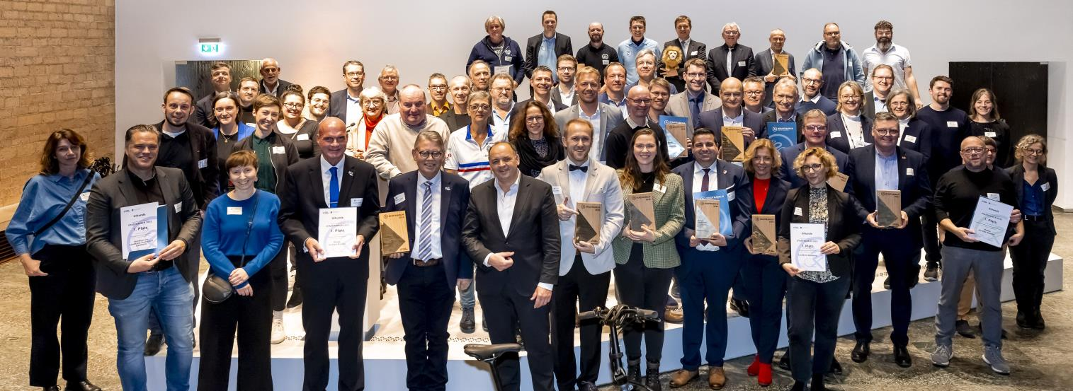
Photo: Climate Alliance / Smilla Dankert
The winners
Who is acknowledged how?
Locally by the municipalities Teams and/or individuals
Internationally by Climate Alliance Most successful municipalities
Notes:
Each municipality should award prizes to its most successful teams and cyclists. Possible categories are:
Largest team: the teams with the most cyclists
Most active team: the teams to cycle the most kilometres (absolute figures)
Team with the most active cyclists: the teams with the most kilometres per cyclist (average)
Commuters and schoolchildren can also be conferred special awards, for example.
At the end of the campaign season, Climate Alliance honours the most successful municipalities during an award ceremony (see next slide).

Slide 15
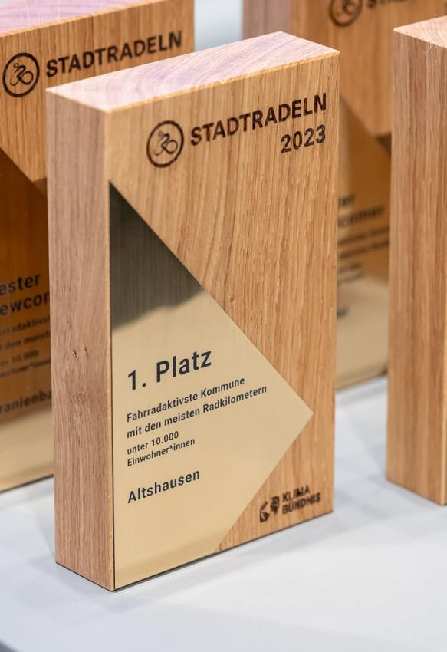
The winners
on the international level
Awards in two categories within five population groups
most active local parliaments
most active municipalities with the most kilometres cycled
First place and best newcomer in each category
Photo credit: Climate Alliance / Smilla Dankert
Notes:
Climate Alliance confers prizes in the following categories:
most active local parliaments (kilometres per parliamentarian in proportion to the total parliamentarians participating)
most active municipalities with the most kilometres cycled (absolute figures)
In both categories, one winning municipality will be determined per population group (see next slide for the participation fees), along with the best newcomer in each population group.

Slide 16
Participation fees in 2024
For municipalities
Number of inhabitants | Climate Alliance members | Non-members
Less than 10,000 | € 505 | € 675
10,000 to 49,999 | € 1.010 | € 1.340
50,000 to 99,999 | € 1.680 | € 2.235
100,000 to 499,999 | € 2.520 | € 3.360
More than 500,000 | € 3.360 | € 4.470
Lump sum* | € 260 | € 340
Subsidies in Germany
available in almost all German federal states
up to 100% of the participation fees covered by state ministries
More information: city-cycling.org/register
Incl. VAT
* Registration via the rural district/region
Notes:
The population group sizes are defined here. Rural districts/regions are additionally able to register their associated municipality for a flat-rate fee.
The participation fees are calculated according to the population group sizes.
Climate Alliance members receive a discount of around 25%.
CLICK: In many German federal states, financial support is available. Details of the current subsidies are available online at city-cycling.org/register.

Slide 17
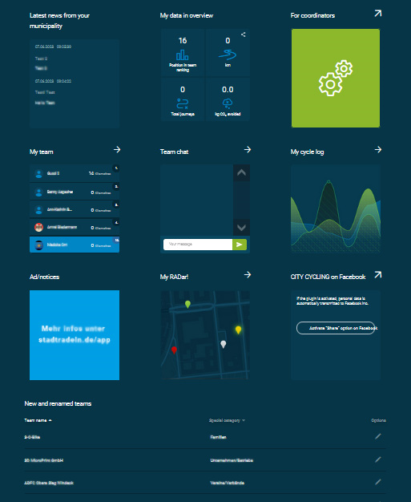
Services
For municipalities
Complete IT infrastructure incl. a municipal subpage on city-cycling.org as a hub for mobilising local participants
CITY CYCLING app incl. tracking function
Optional services:
RADar! reporting platform
RiDE portal with cycling data
Notes:
What do municipalities get for their money?
Climate Alliance provides each municipality with its own subpage on city-cycling.org. As a hub for local mobilisation, it among others includes the following functions:
personal accounts for each individual cyclist following registration to allow them to form teams, chat with fellow team members and record kilometres
display of various municipal results in real time
option of customising cyclists’ contact details, other information and dates
The free CITY CYCLING app provides all information at a glance and can be used to track kilometres.
Optional services:
free use of the RADar! reporting platform during CITY CYCLING (see from slide 24)
use of the RiDE portal with scientifically evaluated cycling data (see from slide 31)

Slide 18
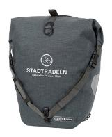
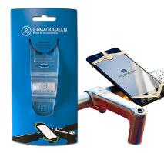
Services
For municipalities
Participation is made as easy as possible for municipalities!
Resources to help municipalities prepare and organise their local campaign
PR materials and document templates to implement the campaign
Giveaways to advertise the campaign locally
Notes:
What do municipalities get for their money?
Materials to prepare and organise the local campaign:
Training and information materials explaining how to run the campaign and mobilise citizens
PR materials and document templates:
customisable flyer, poster and roll-up templates
photo pool
postcards
logos
certificate templates
press release templates
... and much more!
Climate Alliance is on hand to advise and offers a support hotline. It helps municipalities to support cyclists and holds webinars on CITY CYCLING
CLICK: The aim: To make implementation of the campaign as easy and efficient as possible for municipalities
N.B.: Further texts are concealed behind the green field that will only be visible when the screen presentation is started!

Slide 19
Tasks
for local coordinators
Spread the word!
Serve as the contact person for the local population, cyclists and teams, Climate Alliance
Organise the local campaign
Tip: Establish an organising team
Photo: Climate Alliance
Notes:
Advertising via (local) media partners, website, newsletter and official gazette, social media, police, etc. and personal approach through and with businesses, retailers, associations, schools, universities, day-care centres, political decision-makers, etc.
Each CITY CYCLING municipality must appoint at least one local contact person. They are responsible for PR for the campaign and for encouraging citizens to participate. They are also available to answer cyclists’ questions and are at the same time in contact with Climate Alliance. During and after the local campaign period, they check the kilometre entries, specifically for anomalies and for members of the local parliament.
Tip: Establish a CITY CYCLING organising team involving members of local administration and potentially also people from other departments, climate managers, press officers and/or city marketing staff – ADFC, VCD, Agenda 21 as well as other obvious interest groups in the municipality along with committed citizens. Synergies can and should be tapped into and tasks shared! Agencies can also be commissioned to implement the campaign.

Slide 20
CITY CYCLING
A success story
Participating municipalities
Notes:
Almost 300 municipalities more in 2023 than in the previous year!
The municipalities participating in CITY CYCLING cover around 90% of the population in Germany, as almost all large cities participate: all but two cities with more than 65,000 inhabitants participate in CITY CYCLING!
The latest figures can always be viewed online at city-cycling.org/results.

Slide 21
CITY CYCLING
A success story
Participating cyclists
Notes:
In 2023, there were – for the first time! – more than 1 million participants in CITY CYCLING.
The latest figures can always be viewed online at city-cycling.org/results.

Slide 22
CITY CYCLING
A success story
Kilometres cycled
Notes:
Participants cycle an average of more than 200 km per person during the three CITY CYCLING weeks, so just under 10 km per day.
The latest figures can always be viewed online at city-cycling.org/results.

Slide 23
city-cycling.org
Notes:
More information is available online at city-cycling.org.

Slide 24
Notes:
RADar! reporting platform is another component of the CITY CYCLING campaign. All municipalities participating in CITY CYCLING have the option of using it and also offering it to their citizens.

Slide 25
Photo: Climate Alliance
Why a reporting platform?
Active involvement of citizens in the exchange with municipalities
cyclists’ concerns are taken seriously
municipalities transparently demonstrate their commitment to cycling
improved cycling infrastructure means more people cycle
Effective, self-explanatory and easy-to-use tool for cyclists and municipalities/administration
Notes:
Is the cycle path all bumpy? The traffic routing too dangerous? Or the signage confusing? Cyclists often have a good eye for potential improvements and damage to the cycling infrastructure they use every day.
The RADar! reporting platformn allows municipalities to easily access this first-hand knowledge and to transparently incorporate it into their planning.
This has three advantages:
Cyclists are taken seriously as road users with the same rights as all other road users.
Municipalities can demonstrate their commitment to promoting cycling in a public, high-profile way.
Targeted improvements to the cycling infrastructure are possible to encourage even more people to cycle.

Slide 26
What is RADar!
Municipal planning tool for cycling infrastructure
Citizen participation tool
reports can be submitted online or via the RADar! or CITY CYCLING app
municipalities can contact cyclists directly – and vice versa
Optional use by CITY CYCLING municipalities – at no extra cost!
Notes:
Cyclists can use RADar! to submit reports online. They simply need to drop a pin on the digital road map and the municipality will then automatically receive a message. They can then follow up on the report and provide feedback on RADar! about the processing status or by commenting on the report. RADar! can be used for free during the local CITY CYCLING campaign. Cyclists are able to submit reports during the 21-day period that the municipality can access for one year.

Slide 27
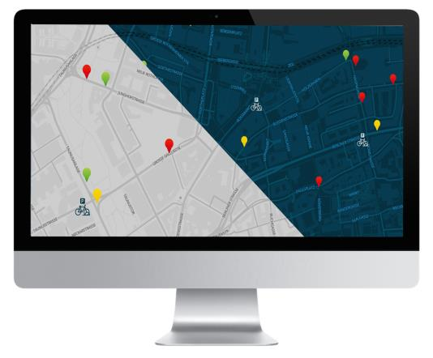
How does it work?
Reports can only be submitted in the municipality’s area of jurisdiction
Only people who have signed up (for CITY CYCLING) can submit reports
fewer “hoax reports”, manageable number of people submitting reports
another reason to participate in CITY CYCLING
Municipalities are free to choose the reporting period:
during the 21-day local campaign
in the summer months
all year round, several times a year
Test phase/manageable period for municipalities
Notes:
All cyclists who have registered for CITY CYCLING can submit reports for the territory/area of responsibility of RADar! municipalities.
They must register to be able to submit reports – this can also help municipalities to increase the number of participants in CITY CYCLING.
If RADar! is to be offered beyond the CITY CYCLING period or independently of CITY CYCLING, various licensing models are available for municipalities (e.g. cyclists can submit reports during a one or three-year period – see the next slides).

Slide 28
RADar! ONE-YEAR LICENCES
Number of inhabitants | Outside of the local campaign period |  | Without participation in CITY CYCLING
 | Climate Alliance members | Non-members | Climate Alliance members | Non-members
Less than 10,000 | € 100 | € 150 | € 220 | € 325
10,000 to 49,999 | € 165 | € 250 | € 360 | € 530
50,000 to 99,999 | € 220 | € 325 | € 470 | € 705
100,000 to 499,999 | € 265 | € 400 | € 585 | € 870
More than 500,000 | € 330 | € 495 | € 725 | € 1.090
Incl. VAT
Notes:
Licence fees for municipalities when RADar! is booked for one year and the reporting period (meaning the period during which cyclists can submit reports) extends beyond the 21-day local campaign or is offered entirely independently of CITY CYCLING. The processing period (= period during which the municipality can process reports) is fixed at one year. The maximum length of the reporting period is also one year. Municipalities are free to choose when they wish to start using RADar!.

Slide 29
RADar! THREE-YEAR LICENCES
The fees indicated are per year, payable in advance for all three years
Number of inhabitants | Outside of the local campaign period* |  | Without participation in CITY CYCLING
 | Climate Alliance members | Non-members | Climate Alliance members | Non-members
Less than 10,000 | € 75 | € 110 | € 155 | € 230
10,000 to 49,999 | € 120 | € 185 | € 255 | € 380
50,000 to 99,999 | € 155 | € 230 | € 330 | € 495
100,000 to 499,999 | € 190 | € 275 | € 405 | € 610
More than 500,000 | € 235 | € 355 | € 510 | € 760
Participation in CITY CYCLING required in all three years
Incl. VAT
Notes:
Licence fees for municipalities when RADar! is booked for three years and the reporting period (= period during which cyclists can submit reports) extends beyond the 21-day local campaign or is offered entirely independently of CITY CYCLING. The processing period (= period during which the municipality can process reports) is fixed at three years. The maximum length of the reporting period is also three years. Municipalities are free to choose when they wish to start using RADar!.

Slide 30
Key features
Free choice of categories that cyclists can submit reports for
Freely adjustable visibility of report status
Prioritisation of reports by urgency
Comment function for citizens and local administration
Multiple access points and forwarding support with shared responsibilities
Positive reports possible, not just “complaints”
Merging of reports for one and the same issue
Customisable automated emails for new reports
Filter and export functions for subsequent processing
Categorisation according to time commitment: short/medium/long-term
Notes:
RADar! offers all of the necessary settings, comment functions, etc. to ensure that communication between the local administration and cyclists is as smooth as possible.

Slide 31
radar-online.net
Notes:
For more information, see radar-online.net.

Slide 32
Notes:
The third campaign component is the product of a past research project by Climate Alliance and the TU Dresden called MOVEBIS, which was funded by the German Federal Ministry of Transport for 3.5 years until 2020.

Slide 33
Data requirements
for cycling planning
Needs analysis
Conception of new offers
Limited resources
Optimisation of existing offers
Notes:
Transport planners must meet countless requirements.
When only limited resources are available, they need data to be able to prioritise projects. Successes can then be reviewed and target achievement measured – data is also needed for this.

Slide 34
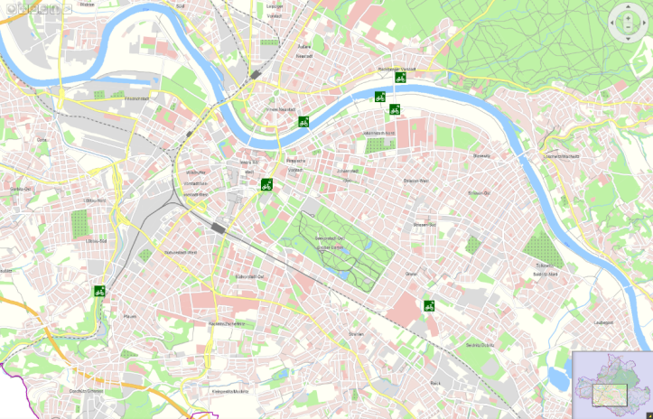
Data availability
for cycling planning
Data situation for motorised individual transport ≠ cycle traffic
Mostly traffic measurements at specific points only
Ancillary network not taken into account
Time-consuming data collection
Bicycle counting stations in Dresden Source: Themenstadtplan
State capital of Dresden
Notes:
There is the added issue that little to no data is usually available for cycling planning. Far more data is available for motorised individual transport. Even the survey on mobility in Germany (mobilitaet-in-deutschland.de) does not provide the data needed for cycling planning.
If data is available in a municipality, then mostly not for all areas, but rather only for specific points where measurements are taken. The map here shows the example of Dresden. The green dots are fixed measuring stations. Data collection is extremely patchy as a conquence as the ancillary network isn’t taken into account at all – so the cycling routes away from the main traffic routes or the routes provided by the city.
The (maintenance) costs for measuring stations are also high, as you need things like counting loops in the ground.

Slide 35
Data availability
for cycling planning
Proportion of smartphone users among the German population from 2012 to 2021 (in %)
Number of active participants in CITY CYCLING
since the campaign was launched
Quelle: Statista 2022
Notes:
Smartphones are a good option for obtaining more comprehensive data. The graph on the left shows the prevalence of smartphones in Germany between 2012 and 2021.
At the same time, the number of users needs to be as high as possible and the group of users as heterogeneous as possible (in terms of age, gender, social background). CITY CYCLING meets these requirements ideally with its over 1,000,000 cyclists in 2023.

Slide 36
Data requirements
for cycling planning
Photo: Climate Alliance
Where do people cycle?
Who cycles?
Why do people cycle?
How many people cycle?
When do people cycle?
Where do cycle routes start/end?
Notes:
Most municipalities lack the traffic data they need for efficient and meaningful cycling planning:
Where and when do people cycle?
Who cycles and how many people cycle?
Why do people cycle?
Where do people start/stop cycling?

Slide 37
Notes:
Climate Alliance and the TU Dresden began seeking answers to all these questions in a joint research project (MOVEBIS) that ended in 2020. This work is now being continued within the RiDE project.
Two spin-offs were established at the TU Dresden, namely flow.d (formerly the Chair of Computer Networks | Faculty of Computer Science) and Vision Velo (formerly the Chair of Transport Ecology | “Friedrich List” Faculty of Transport and Traffic Sciences ), in order to offer high-quality digital cycling data together with the CITY CYCLING team at Climate Alliance.

Slide 38
CITY CYCLING app
Tracking function as the centrepiece of data provision
Notes:
Widespread use of the CITY CYCLING app is decisive, as only in this way can sufficient meaningful data be obtained.
Data is collected and processed in compliance with the European General Data Protection Regulation (EU GDPR). It is already anonymised before it is evaluated scientifically and used in the analyses and graphs exclusively without any personal data.

Slide 39
CITY CYCLING app
7 good reasons to use the app
Good usability and simple tracking
Grow together as a team
Cycling data with added value
Greatest possible data security
Use RADar! to improve conditions locally
From cycling talent to cycling champion
Overview and FAQ on CITY CYCLING
Notes:
The municipalities are called upon to promote use of the CITY CYCLING app among participants in order to obtain as much data as possible and thus sufficient meaningful data for the RiDE portal.
Good usability and simple tracking The app’s menu navigation is self-explanatory and easy to use. Cyclists simply need to click on the start icon in the map tab when they begin cycling and the stop icon when they reach their destination – the kilometres cycled are then recorded and credited to the team and municipality. This eliminates the need to enter data in the kilometre log or log sheet manually and means cyclists always have an overview of the distances they’ve covered at their fingertips.
Grow together as a team Cyclists can see in the app how many kilometres their team has cycled and where it places in the local ranking. The chat function included in the app allows cyclists to cheer their fellow cyclists on or to arrange tours.
Cycling data with added value The information from all of the routes recorded using the CITY CYCLING app flows directly into the scientific evaluation of cycling in the local area. This helps to create a clear picture of the local cycling infrastructure and allows municipalities to see on the RiDE portal (ride-portal.de) exactly where specific improvements are needed. The more routes are recorded using the app, the more accurate the overall picture and the more a municipality can improve its cycling infrastructure.
Greatest possible data security The data is used exclusively for municipal cycling planning. Data is collected and processed in compliance with the stringent European General Data Protection Regulation (EU GDPR). All data is anonymised before the scientific evaluation and is only included in the results as factual data without any personal data. More information on data protection is available on city-cycling.org/privacy-policy.
Use RADar! to improve conditions locally In the integrated RADar! reporting platform, pins can automatically be dropped in exactly the right place on a digital street map using GPS. There’s also the option of taking a photo using a smartphone and attaching it to the report – provided that the municipality has booked RADar! for the CITY CYCLING weeks or beyond, of course.
From cycling talent to cycling champion Cyclists can earn virtual awards in three categories with the new badge system (see next slides). This should help encourage use of the app in a fun way.
Overview and FAQ on CITY CYCLING Information on what exactly CITY CYCLING is all about, what the rules of participation are and what cyclists need to know about using the app is available under the “Profile” tab.
More information:
city-cycling.org/app
city-cycling.org/ride

Slide 40
CITY CYCLING app
Selected features
Badge award system (gamification)
More statistics on the routes tracked:
average speed
travel time
altitude
Export function for the routes recorded
Notes:
The CITY CYCLING app is continuously being developed further to encourage even more people to use it. An achievement system was recently added (see next slide).
One further enhancement: The kilometres tracked are no longer “lost” in other apps, but can be imported there using an export function.

Slide 41
CITY CYCLING app
Badge award system
Notes:
Cyclists can earn virtual awards in three categories thanks to the additional new gamification feature:
kilometres
journeys
series
Cyclists are awarded the “Cycling Talent” badge when they’ve covered 25 kilometres, for example, and the “Cycling Star” badge after 250 km. Similarly, they’re awarded the “Climate Hero” badge after completing 50 journeys. And whoever manages to cycle on all 21 days in a row receives the title of “Series Royalty”!
These awards are intentionally only available to cyclists who use the CITY CYCLING app to track their kilometres so that they “donate” even more (increasingly heterogeneous) data to their municipality.
The use cases developed from this data form the basis for the cycling data offered to municipalities to enable them to better plan their local cycling infrastructure from their computers.

Slide 42
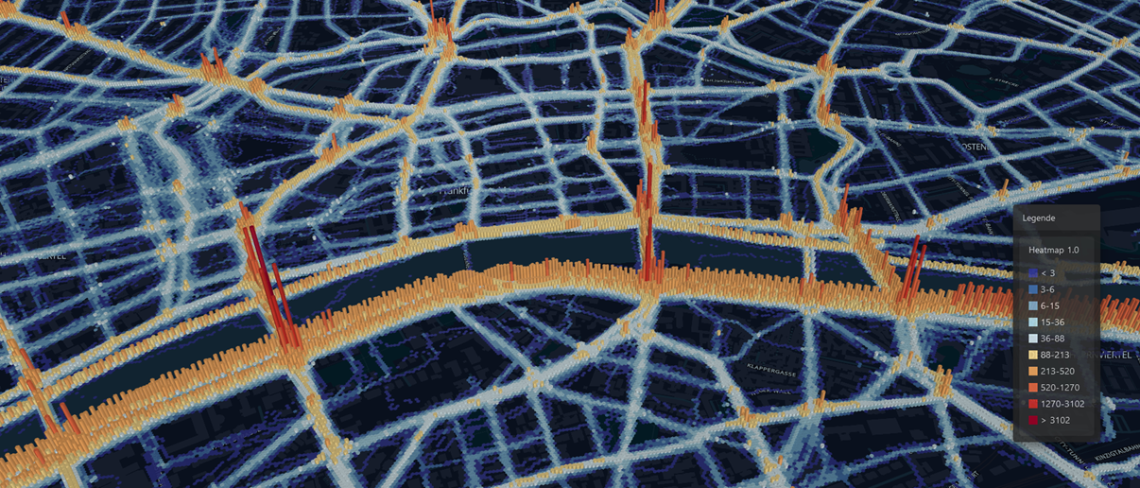
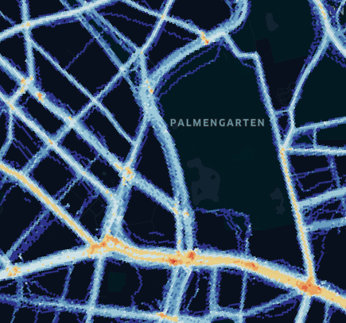
Use case I
Heat map
Source: ride-portal.de
Source: ride-portal.de
Notes:
The data obtained for each municipality is presented in various different maps. One of the maps is a heat map that shows the GPS tracks (or to be more precise, the GPS points) in the municipality. The brighter the sections of a route, the more GPS points there are (and therefore presumably more cyclists).
While heat maps do not provide precise information on the number of cyclists, they do give traffic planners a good first impression of the distribution of cycling traffic in the urban area and can also provide insights into the use of routes that are not “officially” intended for cycling.
CLICK 1: A shortcut through a park, for example: thin blue lines
CLICK 2: The 3D view shows even more clearly where there are a large number of GPS clusters. This can be an indication of longer stops, so waiting times, especially at major crossroads.
A heat map is displayed on city-cycling.org for each municipal subpage. This is updated daily during the 21-day local CITY CYCLING campaign (e.g. see city-cycling.org/frankfurt).

Slide 43
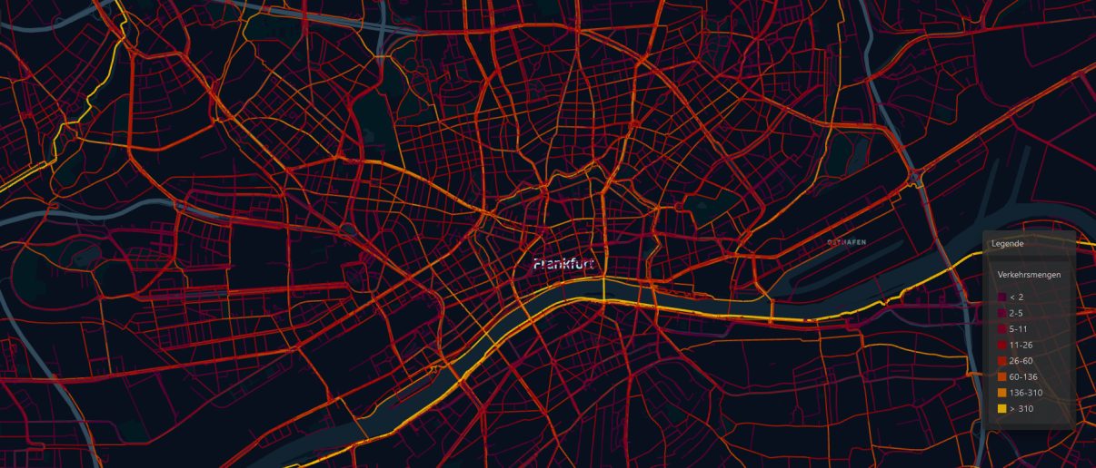
Use case II
Traffic volumes
Source: ride-portal.de
Notes:
This map shows the traffic volumes. It provides precise information (in absolute figures) on how many cyclists have cycled a certain route.
Various filters allow sections with dense or light traffic volumes to be displayed with pinpoint accuracy.

Slide 44
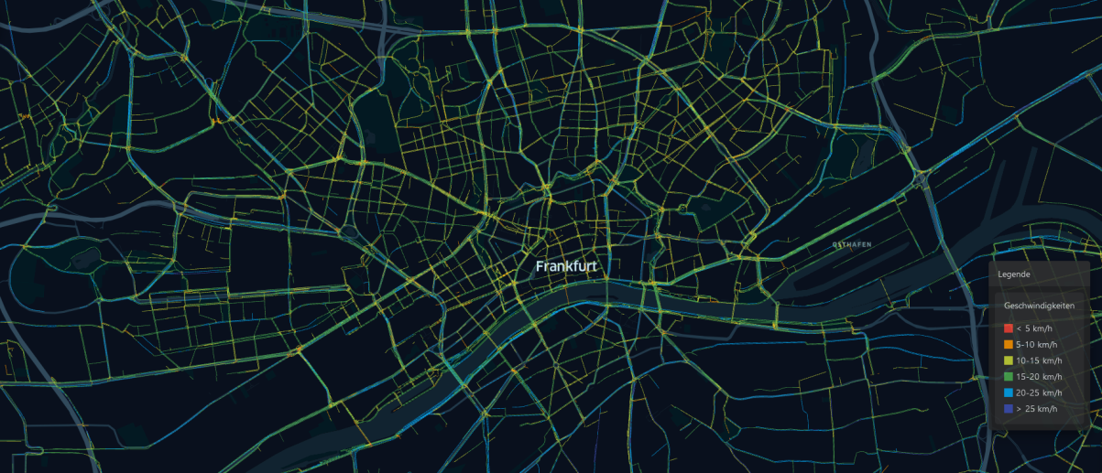
Use case III
Direction-dependent speeds
Source: ride-portal.de
Notes:
This map shows cyclists’ speeds: Red and orange indicate that cyclists are travelling slower and light to dark blue that they’re travelling relatively fast (see legend).
It’s important to be able to see which (traffic) direction cyclists are travelling in at each speed; in “topographically challenging” locations, it is particularly relevant whether cyclists are going uphill or downhill.

Slide 45
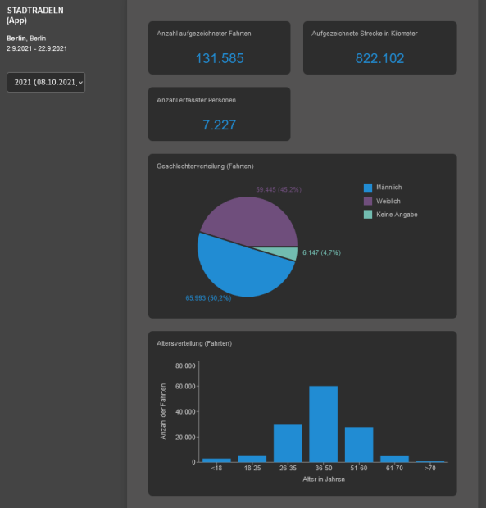
Use case IV
Statistics dashboard
Source: ride-portal.de
Notes:
The composition of the data in the municipalities or statistics about this data is of crucial importance.
A statistics dashboard provides insights into the age and gender distribution and information on the routes recorded. Allowing the demographic quality to be determined entirely transparently at all times.

Slide 46
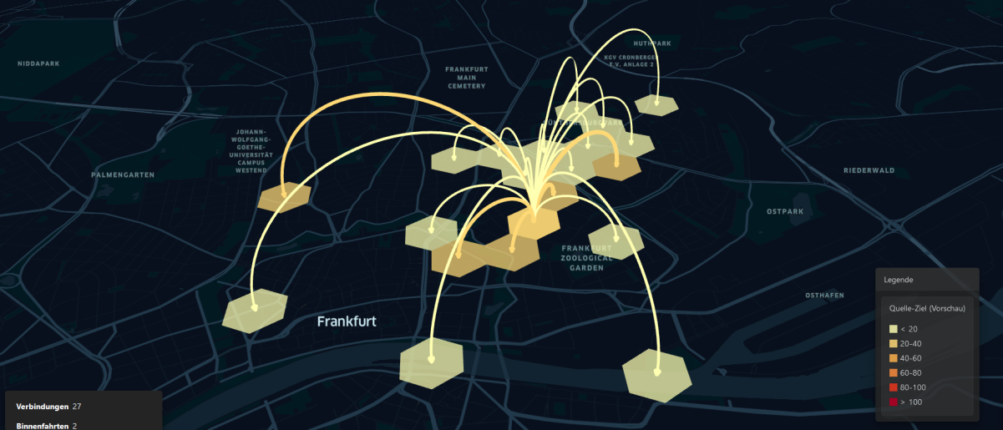
Use case V
Origin-destination relationships
Source: ride-portal.de
Notes:
The origin-destination map allows planners to see which traffic cells people cycle from and to. Filters can be set to specify certain times of day or week days and weekends. Source traffic cells of different sizes can be selected to consider more detailed or more general traffic relationships.

Slide 47
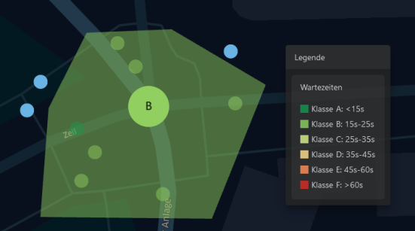
Use case VI
Waiting times at junctions
Source: ride-portal.de
Notes:
The use cases enable more targeted improvements of the local cycling infrastructure, oriented to the needs of a large number of cyclists.
This map shows the waiting times (e.g. at traffic lights or junctions).
What’s special about this map is that it is possible to click on the individual waiting points to see the direction that cyclists arrived at and left the junction.
Users can also create their own junctions by connecting surrounding waiting points and omitting waiting points that are not relevant.

Slide 48
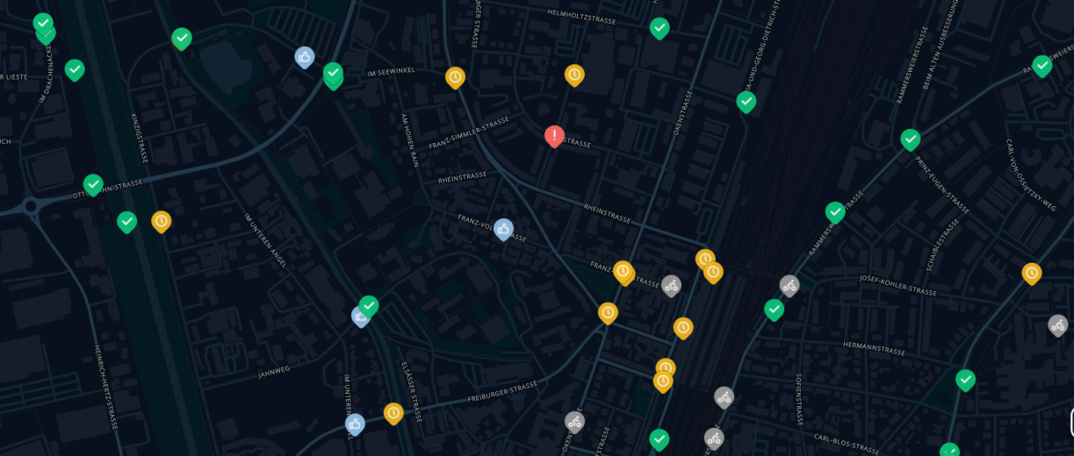
Use case VII
RADar! layer (demo view)
Source: ride-portal.de
Notes:
In the eighth use case, all RADar! reports (see from slide 24) including the reason for reports can be viewed. This allows planners to compare the speeds or traffic volumes with the reports submitted and to check whether there is any correlation, for example.

Slide 49
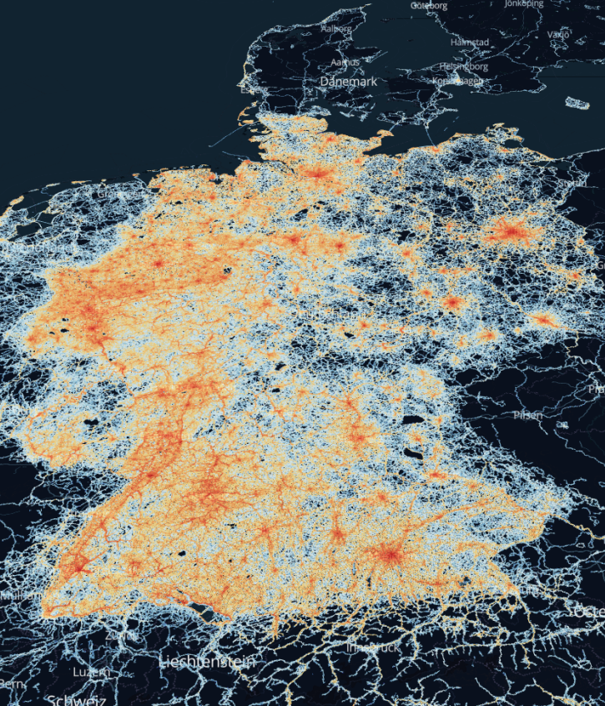
RiDE aims
Heat map for Germany in 2023
Source: ride-portal.de
Support municipal cycling planning
Representative and valid data
Improved analysis algorithms for data processing
Continuous data acquisition and automated result processing
Application to as many municipalities as possible
Notes:
Advantages compared to other providers:
Participants in CITY CYCLING provide an excellent basis for representative and valid data.
Heterogeneous CITY CYCLING user groups: People of all ages, genders and social backgrounds.
In contrast, mainly (around 80%) males aged between 25 and 40 years old use “sport apps”.
Improved analysis algorithms for data processing:
Data from many other providers is a “black box”: Municipalities often don’t know the conditions under which the data was collected and processed.
The data obtained is of a low quality as a consequence and often unsuitable for cycling planning.

Slide 50
National Cycling Plan funding for 2022–2024
For participating municipalities in Germany
Free access to use cases I–IV
heat map and traffic volumes
direction-dependent speeds
statistics dashboard
Discounted access to use cases V–VI
origin-destination relationships and waiting times
Via one user access per municipality to the interactive presentation on the RiDE portal (see ride-portal.de)
Project partners
Notes:
Thanks to a three-year grant from the Federal Ministry for Digital and Transport through the German National Cycling Plan, all German municipalities participating in CITY CYCLING can access use cases I–IV for the campaign years 2022 to 2024 for free via the RiDE portal.
The project partners are once again the TU Dresden and Climate Alliance, who already successfully collaborated from 2017 to 2020 when they laid the foundations for the RiDE portal.

Slide 51
National Cycling Plan funding for 2022–2024
For participating municipalities in Germany
New use cases for the RiDE portal
Average daily traffic forecasting (average daily (bicycle) traffic)
Difference map for the traffic volumes and source-destination relationships use cases
RADar! report dashboard
Enhanced statistics dashboard
Data provided for the 2018–2020 campaign years
Project partners
Notes:
The funding has allowed several new use cases to be added and the algorithms continuously refined.
The data obtained through the CITY CYCLING app is extrapolated to the DTV as a fixed reference value in order to interpret the data (even) better.
The options of displaying a time series and an analysis of different reference periods are being developed so that several CITY CYCLING years can be compared and the actual campaign development as well as any weather influences taken into account. The data from the 2018–2020 campaign years will therefore also be made available and newly developed evaluation processes applied to historical data retroactively.
New functions are to moreover be added, such as a list of all reports from the RADar! reporting platform that is integrated into CITY CYCLING. Municipalities would then have the option of offering this (cf. slide section RADar!).

Slide 52
App usage
RiDE data period
For 2023: (comparative figures from 2022 in brackets)
7.9 million journeys (5.2 million)
64.9 million kilometres (41.5 million)
245 terabytes of data (156 terabytes)
42% app usage among all CITY CYCLING participants
App users
Notes:
Bearing in mind that about one quarter of all participants also enter the kilometres cycled by other people (e.g. a school class or family members), then these statistics and usage rates are very good.

Slide 53
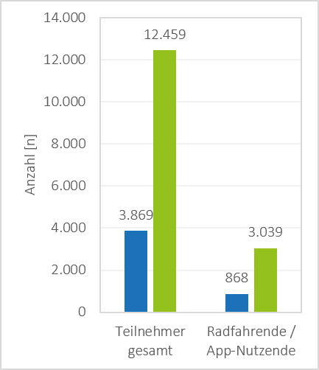
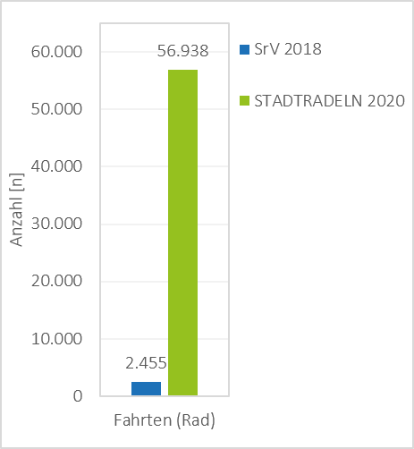
Data source
Sample figures (example of Leipzig)
Comparison of CITY CYCLING and the survey on urban mobility in Germany
Teilnehmer
Notes:
The example of Leipzig is used here to show that significantly more people participated in CITY CYCLING in 2020 than they did in the survey on urban mobility in Germany.

Slide 54
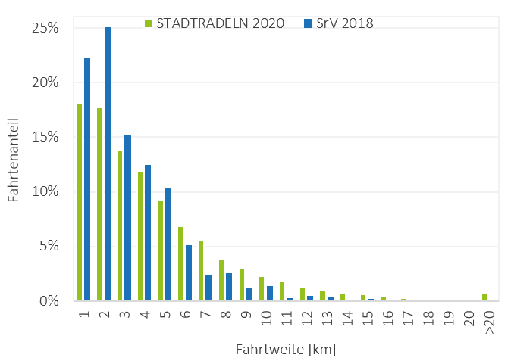
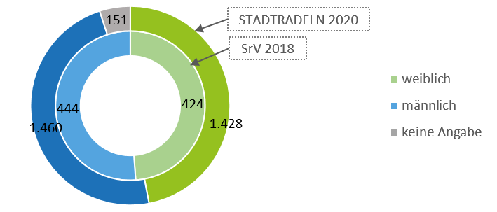
Data source
Sample figures (example of Leipzig)
Comparison of CITY CYCLING and the survey on urban mobility in Germany
Notes:
Households in German were surveyed on urban mobility.
Gender distribution + travel distance distribution for Leipzig, also for 2020.
The gender distribution is balanced and also better than it is in other apps where the gender ratio is often around 80% men, 20% women.
The distances travelled are based on those used in the urban mobility surveys.
This shows that data preparation works!

Slide 55
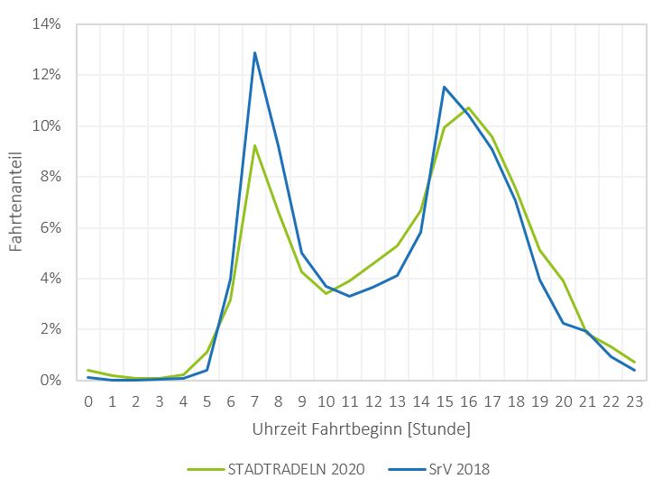
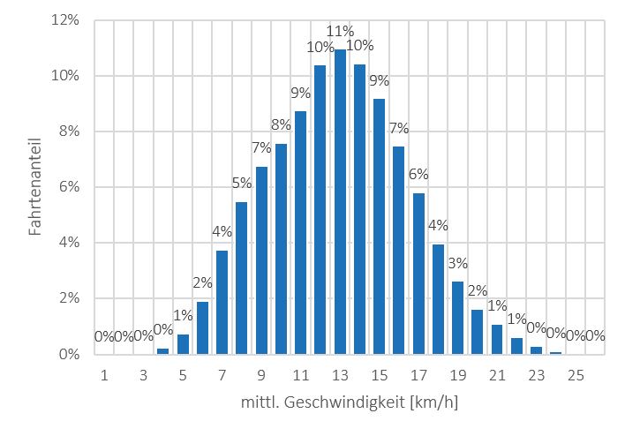
Data source
Sample figures (example of Leipzig)
Comparison of CITY CYCLING and the survey on urban mobility in Germany
Notes:
Travel start time and distribution of the mean speeds for all journeys in Leipzig in 2020.
Here too, the data is similar to the data from the mobility surveys of households.

Slide 56
radverkehr-in-deutschland.de
Notes:
For more information, see radverkehr-in-deutschland.de.
The data portal can be accessed directly via ride-portal.de.

Slide 57
CITY CYCLING, RADar! & Ride
An all-in-one tool
for communication, planning and citizen participation
Photo: Climate Alliance / Felix Krammer
Notes:
With its integrated RADar! reporting platform and RiDE, CITY CYCLING offers a unique all-in-one package!

Slide 58
Thank you!
CONTACT
<Name> <Organisation> <Function> E. T.
CITY CYCLING Team E. info@city-cycling.org T. +49 69 717139-39
Climate Alliance
Eschborner Landstraße 42 – 50 60489 Frankfurt am Main Germany
W. climatealliance.org E. europe@climatealliance.org
city-cycling.org
radar-online.net
radverkehr-in-deutschland.de
Notes:
Please add your contact details to this slide!

Slide 59
Climate Alliance
1990 Establishment of the European network of cities, municipalities and counties for protection of the global climate as an association
2023 Spin-off of Klima-Bündnis Services GmbH into which CITY CYCLING has been integrated since 2024, with the association as a 100% shareholder
Today, Climate Alliance has around 2,000 members in over 25 countries in Europe:
approx. 90 million people live in a Climate Alliance municipality
more than 20% of the EU population
Partnership between European municipalities and indigenous rainforest peoples to reduce greenhouse gas emissions and protect the rainforests
Notes:
Some information on Climate Alliance to finish up – as general background to the whole project.

Slide 60
Climate Alliance
When municipalities join Climate Alliance, they commit to:
continuously reducing their greenhouse gas emissions by 30% every 5 years, with the goal of cutting CO₂ emissions by at least 95% by 2050 (compared to 1990)
halving their per capita emissions by 2030 at the latest (base year: 1990) by
saving energy
using energy efficiently
opting for renewable energies
meeting the long-term goal of 2.5 t of CO₂ emissions per inhabitant and year

Slide 61
Climate Alliance
European Secretariat
Climate Alliance activities
exchange of experience and advice for members
development of methodological approaches to municipal climate action
cooperation with indigenous peoples
representation of municipalities’ interests on the national, European and international levels
conception and coordination of campaigns

